Slide 1
CS1 with a Side of AI:
Teaching Software Verification for Secure Code
in the Era of Generative AI
In-class Activities
(10-15 minutes each)
Amanda Fernandez, University of Texas at San Antonio
Kimberly Cornell, University at Albany SUNY
Notes:
For Activity 4, there are very few slides planned. The goal is to instead get the students into the LLM to practice what we have been introducing in the previous activities.
We start with 2 slides of review of the main takeaways from Activities 1-3, then dive right into examples where the instructor pulls up the LLM and interactively reviews a few prompts - some are “safe bets” and some are “monkeys paws”.

Slide 2
INSTRUCTIONS for instructors ———————————
A recommended script is included in the speaker notes for each slide, beginning with slide 4.
Engage the audience wherever possible.
Be open to Q&A, if/as time permits.

Slide 3
CS1 with a Side of AI: Teaching Software Verification for Secure Code in the Era of Generative AI
Position: CS students need to know how to interact with LLMs and understand how to critically verify any code generated.
LLM activities (10-15 min in-class):
Introductory *need Google account
Goal: Learn to use LLM as a tutor.
Create code with variables, conditionals, loops.
Evaluate - copy/paste into IDE to verify the code compiles & runs.
Prompt engineering
Goal: Learn guidelines to prompt effectively.
Create basic methods.
Evaluate - verify the method does what it is supposed to do.
Verification
Goal: Learn steps to verify the code.
Create code with arrays & methods.
Evaluate - write out the steps in practice.
Practice
Goal: Learn to independently decide when to use the LLM and how to prompt it.
Review all course content.
Evaluate - write out the experience.
Notes:
General outline of the 4 activities (in-class).
From our SIGCSE 2024 paper:
“Our position is as follows:
As AI-generated code becomes the norm for professional developers, CS education needs to shift to incorporate these new tools.
However, redirecting the focus of CS1 courses to more abstract concepts using LLMs can lead to less-secure code generation and novice programmers dealing mainly with black boxes.
Instead, students need to know not only how to interface with the tools but also how to critically verify the code generated for them.”

Slide 4







CS1 “with a side of AI”
Artificial intelligence (AI) is everywhere these days!
It can even help you code!
…but you need to be careful!
These activities will introduce you to LLMs, & establish best practices for programming with them.
ONLINE SURVEY
Participation will not be reflected in your course grades!
Notes:
“Who are you and why are you here??”
Hi! My name is Dr. ______ and I am part of a collaborative team of Computer Science researchers and instructors from UTSA, UAlbany, and Texas State.
Our research effort is affectionately called “CS1 with a side of AI”, and our goal is to introduce you to large language models (LLMs), providing you with an understanding of how they work, in order to be able to effectively and securely use them for programming tasks, here in CS1 and beyond.
If you would take the time to participate in our online survey, we would greatly appreciate your feedback. Please look for 1 more (shorter!) survey toward the end of the semester as well.
We’ll only survey you twice.
We collect this data in order to assess how impactful this information and the AI tools in general are on your CS/programming education.
Please note that these surveys and participation in our study are not a requirement of this course and in no way affect your grades. It is completely voluntary.
If you have any questions at all during this semester about our work, please reach out to any member of our team.

Slide 5
Activity 4:
Practice!
Notes:
I’m back again! This is the last time, I promise. :)
In this last session, we’re putting everything into practice - taking advantage of LLMs for our programming tasks, engineering useful prompts, and doing it in a secure manner.

Slide 6


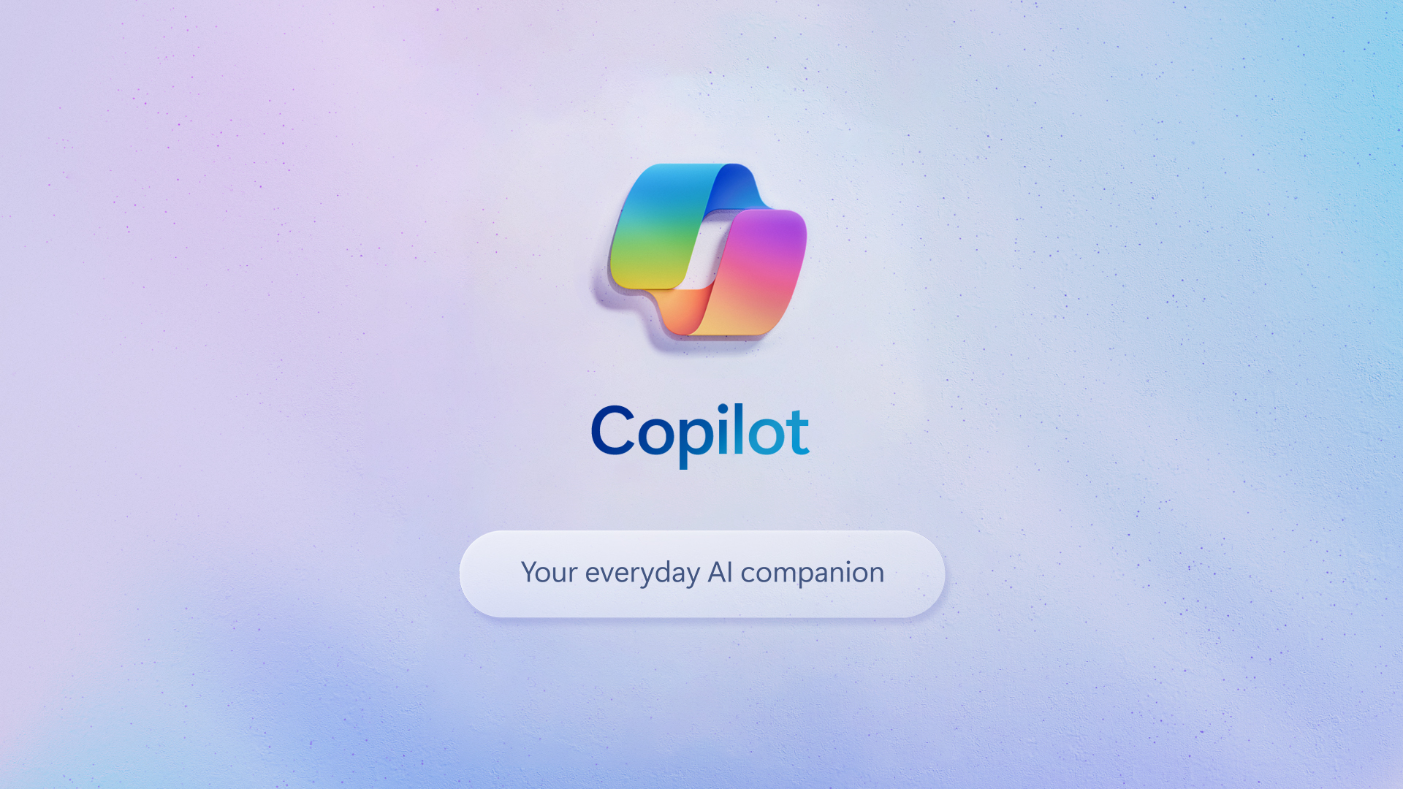
Artificial Intelligence
Large language models (LLMs) are generative A.I. agents capable of conversation.
Trained on 65 trillion tokens (words or phrases)
Generate responses, images, video, or code!
Now available in most programming environments.

Slide 7
How to co-develop code safely with an AI:
Have a conversation.
Provide context and any details in your request, then follow up when you get a response.
Do a code review.
Check that it is “good code” (compiles & follows best programming practices).
Verify the software.
Does the code do what you needed it to do? Is there anything extra or dangerous?

Slide 8
Let’s do this!
I'm a CS1 student learning Java, please explain all future code you generate.
Open a browser
Go to http://gemini.google.com
Provide the initial prompt at right
Try a few prompts together
Notes:
The initial prompt here sets the scene for this conversation.
It lets the LLM know what your background is, so that it contextualizes the results it provides

Slide 9
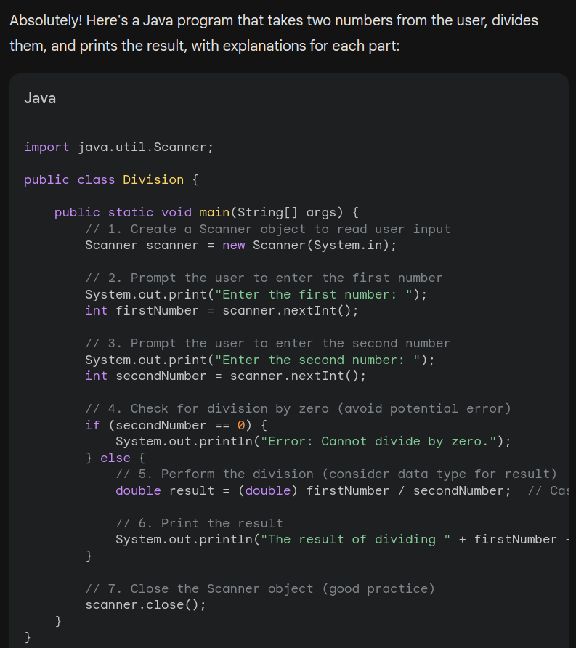
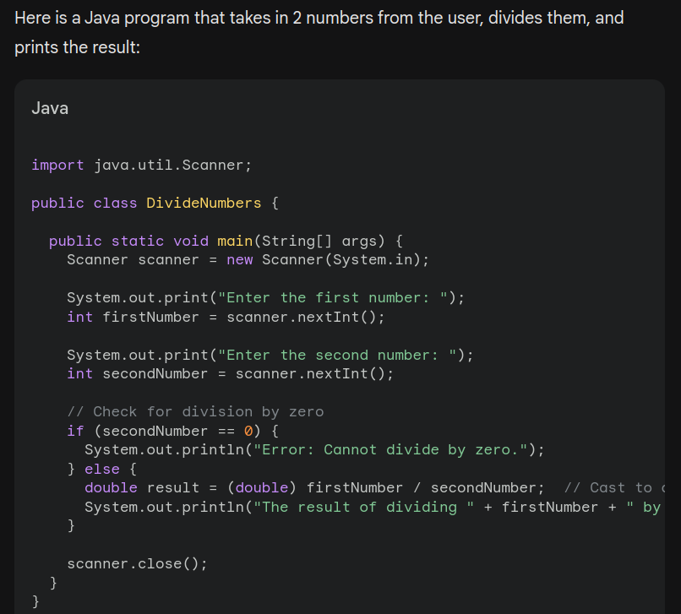
Write a Java program that takes in 2 numbers from the user,
divides them, and prints the result.
Initial Prompt
No Initial Prompt

Slide 10
Prompts that could be Monkey’s Paws
Write a Java program that takes in 2 numbers from the user,
divides them, and prints the result.
What if the user enters 0 for the second number?
When run, the user will get a runtime error for “division by zero”.
Did the LLM warn you about this?
Notes:
These slides are meant to be supplemental to the students, so that they can recreate what we do in class.
Use the prompts in the LLM, discuss the results with students. No need to show these slides.
*Depending on how quickly you go on these, you might leave some of these prompts as “homework” for the students to check out on their own time.
(I was able to do 2 typically)

Slide 11
Prompts that could be Monkey’s Paws
Write a Java program that checks if a number is even
and returns true if it’s odd.
The code generated will (1) check if the parameter is even, then (2) negate that result.
Is that the most efficient way to write a method like this?
We could instead correct the logic - simplify the request.
Notes:
These slides are meant to be supplemental to the students, so that they can recreate what we do in class.
Use the prompts in the LLM, discuss the results with students. No need to show these slides.

Slide 12
Prompts that could be Monkey’s Paws
Write a Java program that takes in a username and password from the user and prints them to the screen.
Was the password stored safely? (Just plain text, or was it encrypted?)
Did the LLM warn you about storing passwords safely?
Notes:
These slides are meant to be supplemental to the students, so that they can recreate what we do in class.
Use the prompts in the LLM, discuss the results with students. No need to show these slides.

Slide 13
Prompts that could be Monkey’s Paws
Write a mobile application in Java that identifies plants from a photo.
This is an extensive task, and difficult to evaluate without prior knowledge of mobile app development, image analysis, and A.I.!
(We might get what we asked for, but how will we evaluate it?)
This is an opportunity to break the problem into much smaller subtasks.
Notes:
These slides are meant to be supplemental to the students, so that they can recreate what we do in class.
Use the prompts in the LLM, discuss the results with students. No need to show these slides.

Slide 14
Wrap up
Activity 4 goal: understand when & how to use LLMs
Thank you for participating!
Please consider completing survey #2 on Canvas this week!

Slide 15
CS1 “with a side of AI”
Artificial intelligence (AI) is everywhere these days!
It can even help you code!
…but you need to be careful!
These activities will introduce you to LLMs, & establish best practices for programming with them.
ONLINE SURVEY
Participation will not be reflected in your course grades!
Notes:
“Who are you and why are you here??”
Hi! My name is Dr. ______ and I am part of a collaborative team of Computer Science researchers and instructors from UTSA, UAlbany, and Texas State.
Our research effort is affectionately called “CS1 with a side of AI”, and our goal is to introduce you to large language models (LLMs), providing you with an understanding of how they work, in order to be able to effectively and securely use them for programming tasks, here in CS1 and beyond.
If you would take the time to participate in our online survey, we would greatly appreciate your feedback. Please look for 1 more (shorter!) survey toward the end of the semester as well.
We’ll only survey you twice.
We collect this data in order to assess how impactful this information and the AI tools in general are on your CS/programming education.
Please note that these surveys and participation in our study are not a requirement of this course and in no way affect your grades. It is completely voluntary.
If you have any questions at all during this semester about our work, please reach out to any member of our team.

Slide 16
Q&A
Notes:
Ask me anything - it’s my last day!
Thank you all again for your participation, we hope these activities have been interesting and useful to you.
Please look out again for 1 last survey to close our study - we have some very basic questions about your interactions with LLMs. As a reminder these surveys and participation in no way impact your course grade, we are just interested in evolving and improving our curricula.
Thank you so much and best of luck on your final exams!

Slide 17

On an unrelated note..
Are you interested in research?

